Slide 1
Bank Term Deposit Marketing Prediction
Group-5
Members:
Sneha v - PGCBAA03A018
Shilpa mridha - PGCBAA03A022
Richa singh - PGCBAA03A027
Preeti Chandra - PGCBAA03A035
Sathyalakshmi n - PGCBAA03A048
sakthivel L - PGCBAA03A054

Slide 2
Data
The data is related with direct marketing campaigns of a Portuguese banking institution. The marketing campaigns were based on phone calls. Often, more than one contact to the same client was required, in order to access if the product (bank term deposit) would be (or not) subscribed.
Dataset have 17 attributes (7 numerical attributes & 10 categorical attributes)including one dependent attribute and there are 45211 instances/datapoints. So we have 16 predictor/independent attributes and 1 dependent attribute.
Features: Age, job, marital, education, defaulted credit, balance, housing loan, Other loan, contact, day, month, duration, campaign, pdays, previous, poutcome, y(has the client subscribed a term deposit?)
Notes:
Notes: The dataset we have chosen is a Banking dataset to

Slide 3
Objective
To find the best model with a high accuracy rate to predict if the client contacted through the marketing campaign will subscribe a term deposit.
Perform basic EDA
Maximum age is 95 and minimum age is 18.
Minimum account balance of customer is in negative and maximum balance is 102127.
Maximum number of contacts performed during this campaign for particular customer is 63 and minimum contact is 1.
Maximum number of days passed by after the client was last contacted from a previous campaign is 871.
Number of contacts performed before this campaign for customer maximum is 275 and minimum is 0.

Slide 4
Data visualization
pdays and duration appears to be important feature
There is a clear distinction in quartile range of pdays for target variable yes and no and there are no outliers in these.
Most contacted clients are from job types: 'blue-collar', 'management' & 'technician'
Most of the clients contacted have previous outcomes as 'unknown'.
Most of the people contacted have tertiary or secondary education.
Only a few clients contacted who are defaulters.
Only a few clients contacted have loan.
Most of people are contacted through cellular
Most of the clients are contacted in the month of May however the success rate is more during march

Slide 5
Data Pre-Processing
No Missing Values
No duplicates
Label Encoding for categorical variable
Minmax Normalization
Checking the presence of outliers
There are outliers in all the numerical attributes except the day feature.
The outliers will not be replaced with another value as they represent most of the numerical data in the attributes.
Correlation
All the features have very less correlation
Feature Selection: ANOVA for numeric features & Chi-Squared Test for Categorical features
"duration" and "poutcome" attributes highly affects the output target.
Prepare the data to train a model – check if data types are appropriate, get rid of the missing values

Slide 6
Models
Logistic Regression
KNN model
The Gradient Boost classifier model
Random forest
The Bagging classifier model
BEST MODEL
After pre-processing the data, then applying various classification algorithms on the data, it was clear that The Gradient Boost classifier model ranks the best with accuracy rate of 0.8991447950457092 followed by The Bagging classifier model 0.897670303745208

Slide 7
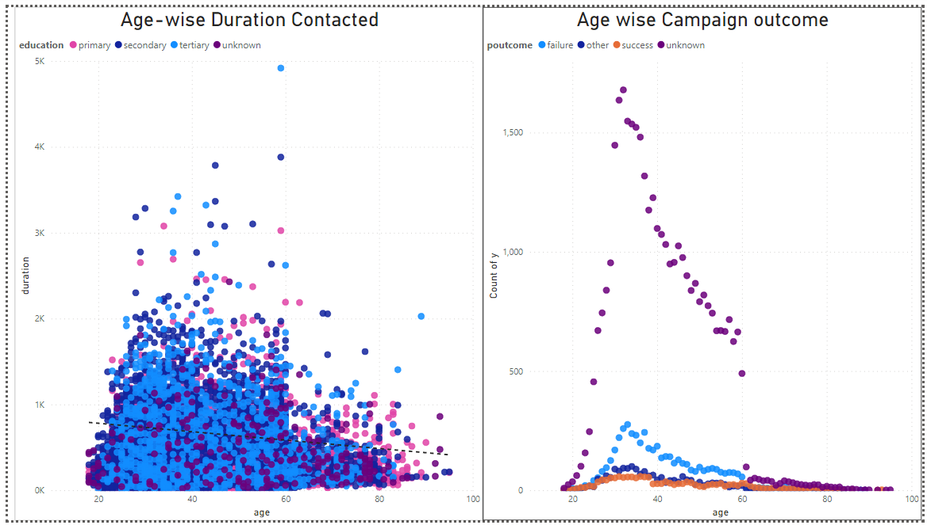
Inference & suggestion

